Slide 1
Integrative Approach to Managing Pain Patients in an Era of
Opioid Use Disorder & Addiction
Randall Hudspeth PhD, APRN-CNP, FAANP
Pain Management Practice Consultant
AANP Representative to FDA’s CO*RE Faculty Advisory Committee

Slide 2

Disclosures
Randall Hudspeth makes the following disclosures:
  1. No relationship with any drug company.
  2. Not part of any private speaker bureau.
  3. Represents AANP on national FDA endorsed CO*RE faculty committee.
  4. Contracted advisor to multiple state Boards of Nursing specific to disciplinary processes for APRN practice breakdown.
  5. Inducted Fellow in National Institute of Regulatory Excellence.

Slide 3
Objectives
Review the national crisis status of opioid use and addiction
Discuss best practices for meeting national safe opioid prescribing practices in cardiovascular patients
Define Substance Use Disorder as it relates to opioids
Discuss effective management of patients with Substance Use Disorder: Assessment to treatment

Slide 4
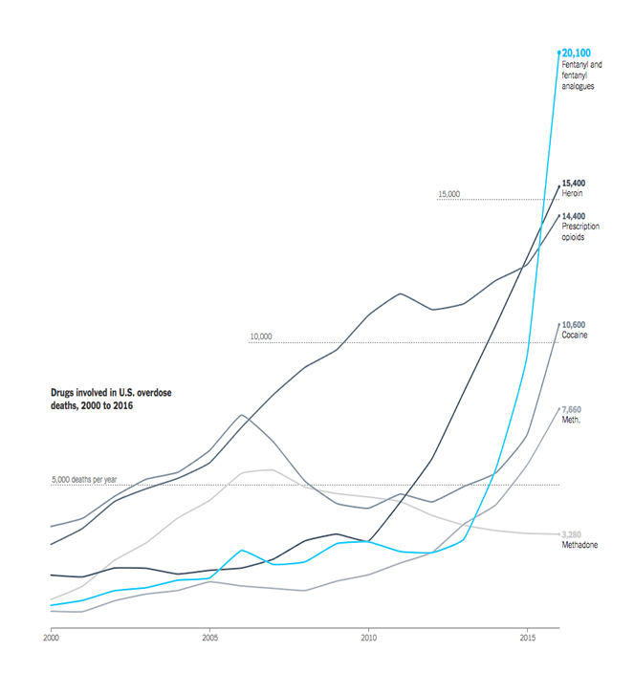
Status of the Current Crisis
Drugs involved in U.S. overdose deaths

Slide 5
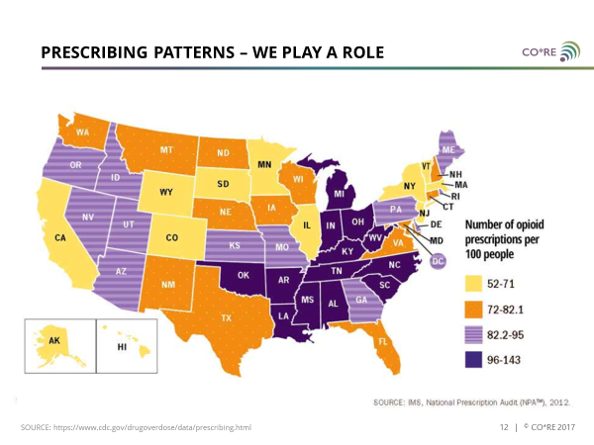
Status of the Current Crisis
Opioid Rx per 100 people

Slide 6
5 Issues to be Considered
Complaints about NP violations of the Uniform Controlled Substance Act are increasing, especially with Full Practice Authority
Opioid prescribing education remains sporadic in NP curricula
Primary care NPs are doing more chronic pain management
Pain management and relief is a common expectation by the public and 80-85% of patients taking opioids do not misuse
Non-pharmacological interventions are not well covered by insurances

Slide 7
Issues to be Considered
Minimal progress by police to impact the wave of illegal drug use.
Attention has shifted to impacting prescribers to decrease numbers of pills and lower dosages.
Less than 25% of prescribers have completed safe opioid prescribing continuing education.
40% of NPs have completed since 2011

Slide 8
What Has the FDA Done?
Funded prescriber education grants through REMS requirements
Supported development of abuse deterrent medication formulations
Gathered panels of experts to bring national standards into a common framework between stakeholder groups
Supported expansion of PDMP program
Increased overall monitoring programs

Slide 9
Prescriber Education
REMS Grant Recipients
CO*RE
Howard University
MediCom Worldwide, Inc
Boston University
Postgraduate Institute for Medicine
University of North Texas Health Science Center
University of South Florida Health Professions (w/Rockpointe)
American Society of Anesthesiologists (w/France Foundation)
Massachusetts Medical Society
University of Kentucky
Antidote Education Company
Johns Hopkins University
Funding is open to any agency.
All must follow the same FDA Blueprint for provider education
Every year a new funding cycle
2019 awards to 12 groups

Slide 10
Pain Behavior Definitions
Tolerance—happens when a dose is used over a period of time and an increased dose is required to achieve the same effect.
Addiction--putting yourself or others at risk, through behaviors or illegal actions to obtain a drug or to misuse a drug.
Pseudo-addiction—behaviors exhibited due to the fear of being in pain. The behaviors resolve when the pain resolves.

Slide 11
Why Tolerance is Deadly
Tolerance is responsible for increasing overdose situations.
Tolerance develops due to external opioids being able to desensitize brain’s own natural opioid system and being less responsive over time.
Periods of intentional or situational abstinence yield tolerance loss.
Resumed use at old dose level yields overdose.

Slide 12
Provider Education Outline
Focus is on Safe Opioid Prescribing
4 Phases of safe prescribing are outlined
Assessment of pain, risk and opioid need
Trial of an Opioid
Maintenance of Opioid Therapy
Termination of opioid treatment

Slide 13
Phase One: Assessment of Risk and Pain
Assessment includes the normal components: PMH, Social Hx, Family Hx, Medication & drug history
Pain specifics: location, intensity, quality, onset/duration, patterns
  Relieving factors
  Causes of increased pain
  Effects on physical, emotional and psychological health
  Current pain and function

Slide 14
Past Medical History
Illness relevant to effects or metabolism of opioids
  Pulmonary disease
  Constipation
  Nausea
  Cognitive impairment
  Hepatic or renal disease
Illnesses possibly linked to SUD
  Hepatitis
  HIV
  TB
  STDs
  Trauma/burns
  Cardiac disease
  Pulmonary Disease

Slide 15
Risk Factors for Opioid Misuse
Use of controlled medications, prescribed or non-prescribed
Alcohol & Tobacco use
History of Sexual abuse
Onset of sexual activity at early age
Family history of substance abuse
Pt. or Family history of psychiatric disorders
Age 16-45

Slide 16
RISK ASSESSMENT TOOLS
TOOL | # OF ITEMS
PATIENTS CONSIDERED FOR LONG-TERM OPIOID THERAPY
ORT Opioid Risk Tool | 5 | patient
SOAPP® Screener and Opioid Assessment for Patients with Pain | 24, 14, & 5 | patient
DIRE Diagnosis, Intractability, Risk, and Efficacy score | 7 | clinician
CHARACTERIZE MISUSE ONCE OPIOID TREATMENT BEGINS
PMQ Pain Medication Questionnaire | 26 | patient
COMM Current Opioid Misuse Measure | 17 | patient
PDUQ Prescription Drug Use Questionnaire | 40 | clinician
NOT SPECIFIC TO PAIN POPULATIONS
CAGE-AID Cut Down, Annoyed, Guilty, Eye-Opener tool, Adapted to Include Drugs | 4 | clinician
RAFFT Relax, Alone, Friends, Family, Trouble | 5 | patient
DAST Drug Abuse Screening Test | 28 | patient
SBIRT Screening, Brief Intervention, and Referral to Treatment | Varies | clinician
ADMINISTERED BY
Notes:
This slide identifies contemporary commonly used risk for abuse assessment tools. Note that different tools are appropriate for use at different times during treatment. For example, having patients complete an ORT at each visit when they are chronic patients is not appropriate.
Use an initial screening tool before a trial of an opioid is started, and use an appropriate tool during treatment at intervals or when misuse is suspected.
The ORT is a brief 5-question measure to classify a patient as high, medium, or low risk for misusing opioids prescribed for pain—it may be better suited to primary care settings that have a predominantly low-risk patient population.
The Screener and Opioid Assessment for Patients with Pain (SOAPP), the Diagnosis, Intractability, Risk, Efficacy (DIRE) instrument, and the Opioid Risk Tool (ORT), all appear to have good content, face, and construct validity.
A review of tools found that the SOAPP had the best psychometric properties, and may be particularly effective in high-risk settings.

Slide 17
OPIOID RISK TOOL (ORT)
Mark each box that applies |  | Female | Male
1 | Family history of substance abuse
 | Alcohol
 | Illegal drugs
 | Prescription drugs
2 | Personal Hx of substance abuse
 | Alcohol
 | Illegal drugs
 | Prescription drugs
3 | Age between 16 and 45 yrs
4 | Hx of preadolescent sexual abuse
5 | Psychologic disease
 | ADD, OCD, bipolar, schizophrenia
 | Depression
ADMINISTER
1
3
2
3
On initial visit
Prior to opioid therapy
4
4
3
3
4
4
5
5
SCORING (RISK)
1
1
0-3: low
4-7: moderate
  ≥8: high
3
0
2
2
1
1
Scoring Totals:
SOURCE: Webster LR, Webster RM. Pain Med. 2005;6:432-42.
Notes:
Complete the ORT using an imaginary patient (or yourself).
Discuss what the scoring means and how the results should be documented in the record.
Discuss how to discuss with the patient and how to document the conversation.

Slide 18
Other Assessment Risk Tools
Urine Drug Testing
PDMP checking
Depression screening tools
Enjoyment of Life score (PEG)
Physical Exam
  Traditional
  Add pain related/focused exam

Slide 19
Phase TWO: Trial of an Opioid
PPA
Establish a Patient-Provider Agreement (PPA)
Informed Consent
Use an Informed Consent to document risk and benefit discussion and patient being informed
Functional Goals
Establish functional goals
Time
Expect a trial to last weeks to months
Drug
Drug family and dose changes are normal during a trial

Slide 20
Phase THREE:
Maintenance of Opioid Therapy
Dose changes may be done in time, usually as a result of tolerance
Normally, changing drug families is not done, but it is a possibility
This phase can last months to years

Slide 21
Phase FOUR:
Termination of Care
Reasons to terminate
The pain resolves and opioids no longer needed
Pt. needs a higher level of service & is referred
Pt. relocated out of service area
Pt. is incarcerated
Pt. violated PPA (with or without a probation time)
Requirements
Treat all pts using the established practice termination policy
Provide the required coverage time to transition care
Willing share records with new provider if appropriate release is obtained

Slide 22
Substance Use Disorder (SUD)

Slide 23
Substance Use Disorder
(Opioid Use Disorder)
Defined as a condition in which the use of one or more substances (alcohol or drug) leads to a clinically significant impairment of health or functional issues at home, school or work.
Although the term substance can refer to any physical matter, in the context of this presentation, “substance” is limited to
opioid drugs.

Slide 24
Defining Substance Use Disorder
Defined by American Psychiatric Association [APA] and diagnostically replaces terms including substance addiction and substance abuse disorder.
May 2013 termed in DSM-5 manual and addresses both addictive and non-addictive dysfunction.
8 Categories of drugs included for diagnosis
  Alcohol
  Cannabis
  Hallucinogens (LSD, etc.)
  Inhalants
  Opioids
  Sedatives
  Stimulants (cocaine, methamphetamine)
  Tobacco

Slide 25
Recognizing the Drug Abuser
Unusual behaviors with staff and in waiting room
Assertive personality, demanding action
Extremes in appearance, overdressed to slovenly
Had unusual knowledge of medications & allergies
Textbook history or very vague
No regular provider, no health insurance
Reluctant to provide history information
May have psychiatric disorders
Cutaneous signs of abuse, skin lesions, scars
Visitor to area who has lost or forgotten Rx

Slide 26
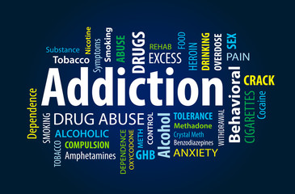

Assessing the Patient to Discover
What Are You Dealing With?
Regular pain patient
Inappropriate Use of a Prescribed Opioid
Using or Addiction to recreational drugs obtained illegally and seeks recovery
OUD patient in treatment who has a new pain issue requiring more drug

Slide 27
Keys to Assessment
Not all Safe Opioid Prescribing Screening tools will apply to the SUD population
Use effective abuse specific interview skills
Recognize the high rate to psychiatric and medical comorbidity and screen for both
Identify the stage of addiction
Assess the kind of support and referral necessary if you cannot provide care
Set limits on treatment

Slide 28
4 Stages of Drug Addiction
Stage ONE—Experimentation—use out of curiosity or peer pressure/rite of passage. No change in behavioral or emotional context. Use is contained.
Stage TWO—Social—Part of a social situation or for acceptance. Person feels normal and contains use to social situations.
Stage THREE—Instrumental--Substance abuse first appears. Use escalates and tolerance develops. Decreased social actions, more isolation, interactions focus on areas where drugs are used.
Stage Four—Compulsive— Full blown addiction. Risky behaviors to get drugs. Social circumstances fall apart.

Slide 29
Pain Versus Addiction
Pain- 5As
Addiction- 5Cs
Analgesia
Activity/Function
Aberrant Behavior
Adverse Effects
Affect
Control, Loss of
Compulsive Use
Craving Drug
Continued Use
Chronic Problem

Slide 30
Assessment Components Comparison
Pain patient with
unknown risks
Substance Use Disorder patient with known risks
Opioid Risk Tool
Urine Drug Screen
PPA
Informed Consent
Trial prescribing to determine correct drug and dose
Drug Screen Tool [NIDA]*
Urine Drug Screen for undisclosed substances
PPA with modifications
Informed Consent
Trial not appropriate—already using
Consider abuse deterrent formulations
NIDA: National Institute on Drug Abuse: tool available at
www.drugabuse.gov/nmassist/

Slide 31
Three Phases of
Assessment & Treatment
Use a validated tool (NIDA Drug Screen).
  Guides clinicians through a series of questions to identify risky substance use in adult patients.
  Accompanying resources assist clinicians in providing patient feedback and arranging for specialty care.
Assess and treat medical comorbid urgent issues.
Refer to specialty treatment if available.

Slide 32
Assessment Question
If the answer is…
Quick Screen Question to identify recent use…
Used illegal drugs or prescription medications for nonmedical reasons one or more times, then do a full screen.
Use National Institute of Drug Abuse [NIDA] Modified ASSIST or other validated screening tool
“In the past year, how many times have you used alcohol, tobacco products, prescription medication for nonmedical reasons or illegal drugs?”

Slide 33
NIDA Modified Assist Tool
Screening for drug use allows clinicians to:
  Identify drug use early and prevent the escalation to addiction.
  Increase awareness of the interaction of substance use with a patient's medical care, including potentially fatal drug interactions.
  Identify patients in need and refer them to specialty treatment
The NIDA Quick Screen was adapted from a single-question screen for drug use in primary care by Smith et al. 2010 and the National Institute on Alcohol Abuse and Alcoholism's Helping Patients Who Drink Too Much: A Clinician's Guide Updated 2005 Edition. The NIDA-Modified ASSIST (NM ASSIST) was adapted from the World Health Organization (WHO) Alcohol, Smoking and Substance Involvement Screening Test (ASSIST), Version 3.0.

Slide 34
NIDA Modified Assist Tool
Available at:
  https://www.drugabuse.gov/nmassist/

Slide 35
What Are You Dealing With?
Regular pain patient?
Inappropriate Use of a Prescribed Opioid?
Using or Addiction to recreational drugs obtained illegally?
OUD patient in treatment who has a new pain issue requiring more drug?

Slide 36
Regular Pain Patient
Treatment Steps
Determine a probable length of time that pain will be an issue
Short term pain
  Use the CDC guidelines
  Lowest effect dose of lowest intensity medicine to manage the situation (example: start with hydrocodone versus hydromorphone)
Long term pain
  Use the CDC guidelines
  Use the procedure outlined in CO*RE REMS

Slide 37
What Are You Dealing With?
Regular pain patient?
Inappropriate Use of a Prescribed Opioid?
Addiction to recreational drugs obtained illegally?
OUD patient in treatment who has a new pain issue requiring more drug?

Slide 38
Inappropriate Opioid Users
Sometimes Difficult to Identify
Recreational Users
People with Addictions or escaping emotional pain
Pain Patients seeking more relief

Slide 39
Inappropriate Use of a Prescribed Opioid
Assessment and Treatment steps
  Firing the patient is not the appropriate first move.
  Investigate the reason, frequency, & effect.
  Determine the stage of addiction or misuse.
  UDT to confirm what the patient says and no other drugs are identified.
  Reaffirm the PPA.
  Review or re-institute an Informed Consent.

Slide 40
Inappropriate Use of a Prescribed Opioid
  Dose change? More or less?
  Consider a lesser potent drug/dose on a more frequent schedule if BT and issue.
  Closer monitoring and thorough documentation is necessary.
  Validate whatever the patients tells you if you can. Be cautious that what they tell you is 100% truthful.

Slide 41
What Are You Dealing With?
Regular pain patient.
Inappropriate Use of a Prescribed Opioid.
Using or Addiction to recreational drugs obtained illegally.
OUD patient in treatment who has a new pain issue requiring more drug.

Slide 42
Nature of Treating Addiction
TREATMENT STAGES
Withdrawal from the problem opioid (Detox)
Begin Recovery
Stay engaged with Recovery
Live addiction free and maintain support systems

Slide 43
Assessment and Decision Making
Become aware of any police or legal status issues, such as parole violations, etc.
Do you need to notify police or parole officer?
Assess to confirm addiction stage.
Are you qualified for drug addiction treatment of stages 2-3-4?
Consider consultation or referral.
Consider Medication-Assisted Treatment if you are qualified to manage MAT.
Abstinence-only programs are also an option, but may require in-patient stay.

Slide 44
Medication Assisted Treatment
GOAL
The goal of MAT is to recover from addiction.
  MAT does not replace one addictive drug with another.
  MAT is intended to provide a safe, controlled level of medication to overcome the use of the problem opioid.

Slide 45
3 Agonist Medication Classes for Addiction Treatment
Agonist medications developed to treat opioid use disorders work through opioid receptors but are safer and less likely to produce the harmful behaviors that characterize addiction, because the rate at which they enter and leave the brain is slower.
Opioid Receptor Agonists-- methadone (Dolophine or Methadone)
Partial Agonists– buprenorphine (Subutex, Suboxone, Zubsolve) that produce diminished receptor response
Antagonists—naltrexone (Revia, Depade, Vivitrol) block receptor and block reward effects

Slide 46
Medication Actions
Methadone and Buprenorphine
  Brain thinks it is still getting the problem opioid
  Usually the person has normal feeling
  Withdrawal does not occur
Naltrexone
  Acts to block opioid effects
  Inhibits the feeling of “getting high” if opioid is used
  Good choice for relapse prevention

Slide 47
Withdrawal Symptoms
Yawning and other sleep problems
Sweating more than normal
Anxiety and nervousness
Muscle aches and pains
Stomach pain, nausea, sometimes vomit
Diarrhea
Generalized weakness

Slide 48
Treating Addiction
People can safely take treatment as long as needed, months to years or a lifetime
It is hard to be successful alone, patients need support systems
Family/friend counseling is critical to success

Slide 49
What Are You Dealing With?
Regular pain patient.
Inappropriate Use of a Prescribed Opioid.
Using or Addiction to recreational drugs obtained illegally.
The Opioid Use Disorder (OUD) patient in treatment who has a new pain issue requiring more drug?

Slide 50
The Problem
A patient is undergoing treatment for SUD or OUD and is routinely taking one of the three meds, methadone, buprenorphine to naltrexone.
Scenario 1: The patient is scheduled for an elective surgery and you can anticipate treating post-op pain.
Scenario 2: The patient has an unplanned admission due to accident, trauma, etc.

Slide 51
Scenario ONE Treatment Options
Coordinate treatment plan with provider treating addiction. Decide stop-no stop plan. If stop, cease the drug and start an equivalent dose opioid that will be used or increased post-op. Set a time limit before restarting the agonist again.
Maintain the drug knowing that the post op opioid will compete for the receptor and may not relieve pain. Use Adjunctive tx.
Maintain the drug and use a non-opioid such as tramadol, IV Acetaminophen. Use Adjunctive tx.

Slide 52
Scenario TWO Treatment Options
Patient with trauma or other unplanned admit.
  Determine when last dose taken.
  IV pain med with close monitoring knowing increased doses may be needed.
  Calculate conversion IV to oral dose as soon as possible. Use Adjunctive tx.
  Maintain the agonist therapy if pain meds to be used for 7 days or less.

Slide 53
Pain Treatment Options
Reduce pain
Physical
Modalities
Orthotics
Exercise
Manual therapies
Medication
NSAIDs
Anticonvulsants
Antidepressants
Topical agents
Opioids & others
Cultivate
well-being
Restore function
Procedural
Nerve blocks
Steroid injections
TPIs
TENS Stimulators
Psychobehavioral
Cognitive behavioral
Tx mood/trauma issues
Address substance
Improve quality of life

Slide 54
Alternative Therapies

Slide 55
Cognitive Behavioral Interventions
I can’t handle the pain
Thoughts
If I move, I’ll hurt more
No one cares. No one can fix me.
Sympathetic arousal Muscle tension
Pain
Deconditioned disengaged,
Anxiety, panic
Muscle tension, Irritable
Feelings
Powerless, paralyzed, depressed
Behaviors
Anger & fear

Slide 56
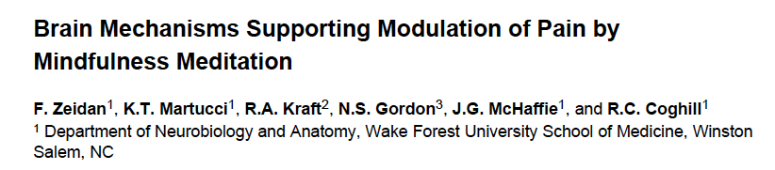
Meditation/Relaxation
J Neurosci . 2011 April 6; 31(14): 5540–5548
Varied techniques
  Progressive muscle relaxation
  Autogenic training
  Hypnosis
  Guided imagery
  Meditation
    Mindfulness
    Mantra/focus-based
  Attention to breath

Slide 57
Movement & Exercise
Stretch, aerobic, toning
Pain reduction mechanisms
  Improved circulation and healing
  Restores movement through stretch
  Reduces spasm through toning
  Mobilizes joints reducing mechanical stress
  Possible impact pain modulation thru endorphin system
  Golightly et al, 2012; Sullivan AB et al, 2012; Busch AJ, 2012
Possible “dysfunctional endogenous analgesia” in some pain syndromes (including FM)
  Exercise without increasing pain Nijs J, Pain Physician. 2012

Slide 58
Movement & Exercise
Addiction & Pain
Documented in addiction treatment & recovery
Relevant for pain as well
  Endogenous opioid & dopamine enhance mood
  Reduced depression
  Alleviates sleep disturbances
  Improves cognitive function
  Improved self-efficacy
  Decreases stress reactivity
  Brown et al, 2009; Brown RA et al, 2010; Smith MA et al,

Slide 59
Group Support
Oriented to Positive Self-Management
Chronic pain support groups through ACPA
  Positive messaging & great resources “Half the battle is won when you begin to help yourself”
  Strong leadership and advisory board
Chronic Pain Anonymous
  Spiritually-based, based on AA, NA
  In person, web based and phone based
  www.chronicpainanonymous.org
AA & NA & RR & Smart Recovery
  For patients with SUDs
  www.aa.org, www.na.org
Disease specific support groups
  Variable in format and quality

Slide 60
Engagement
(Distraction)
Burn patients
Virtual reality immersion state during debridement
35-50% reduction in pain during debridement
Less opioid required
Hoffman et al, 2008
Focus on Pain Engaged (Distracted)
Insula
Thalamus

Slide 61
Ethical Considerations
Benefits
Risks
Relief of pain
Improved function
Restored quality of life
Side effects
Toxicity
Unintended consequences

Slide 62
Ethical Concerns in the Use of Opioids
Beneficence-act of doing good
  Relieve pain
Non-Maleficence – doing no harm
  Prevent addiction, overdose, other harms
Autonomy – support patients in self determination
  Can a person with addiction act autonomously in their best self-interest?
Justice – equitable treatment
  Should all patients have equal access to opioids

Slide 63
Resolving Ethical Tension
Good Medical Care
Consider potential risks and benefits of opioids (and other treatments) in individual context
  Behavioral health co-morbidities
  Physical risk factors
  Severity of pain
  Efficacy and risks of alternatives
Structure pain treatment to reduce risk
Monitor closely to detect emerging signs of risk

Slide 64
Conclusion
Know the national safe opioid prescribing standards.
Understand state-specific laws related to prescribing.
Document well.
Seek CE, consultation and peer review in areas of practice that are new or not a part of the NP curriculum.
If you become the subject of an investigation cooperate with investigators.
Consider hiring an attorney.

Slide 65
Thank you
Questions???

